Slide 1




PDS
AWS Security: KMS, WAF, and Shield
Computer Vision
https://github.com/siagianp
https://www.youtube.com/@AmelOline/videos
https://github.com/amelcharolinesgn2/Cloud-Infrastructures
https://github.com/amelcharolinesgn2/ClouD-Infrastructure-SISKA-2025
https://github.com/amelcharolinesgn2/CCNA1
https://github.com/amelcharolinesgn2/CCNA2
https://github.com/amelcharolinesgn2/AWS Certificate
Notes:
Lab Session 01: AWS Compute Foundations – EC2, Networking, and Application Deployment Lab Session 02: Identity and Access Control with IAM Lab Session 03: Cloud Storage Solutions – S3, EBS, and EFS Lab Session 04: Database Services – RDS, DynamoDB, and ElastiCache Lab Session 05: Load Balancing and Auto Scaling Lab Session 06: Container Orchestration with ECS, Fargate, and EKS Lab Session 07: Serverless Computing with Lambda Lab Session 08: Monitoring, Logging, and Security Auditing Lab Session 09: Infrastructure as Code – CloudFormation, CDK, and Terraform Lab Session 10: CI/CD Pipelines – App Runner, CodePipeline, GitHub Actions, and CodeDeploy Lab Session 11: AI/ML Services – Rekognition, Comprehend, Translate, and SageMaker Lab Session 12: Hybrid Cloud Networking – VPC Peering, Transit Gateway, VPN, and Direct Connect Lab Session 13: Security and Compliance – AWS Config, GuardDuty, Security Hub, and KMS Lab Session 14: Disaster Recovery and Business Continuity – AWS Backup, Multi-Region, and Failover Lab Session 15: Migration and Modernization – DataSync, DMS, MGN, Containers, and Serverless
Lab Session 16: Cost Management and Optimization – Cost Explorer, Trusted Advisor, Budgets, and Well-Architected
https://www.youtube.com/watch?v=SOTamWNgDKc&t=19604s

Slide 2
AWS Security: KMS, WAF, and Shield
Advanced Cloud Security

Slide 3
Introduction to AWS Security
AWS Security is based on the Shared Responsibility Model.
AWS provides built-in security tools like KMS, WAF, and Shield to help protect applications and data.
Security services help in
  encryption,
  access control, and
  DDoS protection.

Slide 4

AWS Key Management Service (KMS)
AWS KMS is a managed service for creating and managing encryption keys.
It supports AWS services like S3, EBS, and RDS for data encryption.
Key policies and IAM permissions control access to keys.
Integration with CloudTrail for logging key usage.

Slide 5
How AWS KMS Works
Uses Customer Master Keys (CMKs) to encrypt and decrypt data.
Supports Automatic Key Rotation for security.
Envelope Encryption: KMS encrypts a data key, which then encrypts the data.
Integrated with AWS services like Lambda, S3, RDS, and CloudTrail.

Slide 6
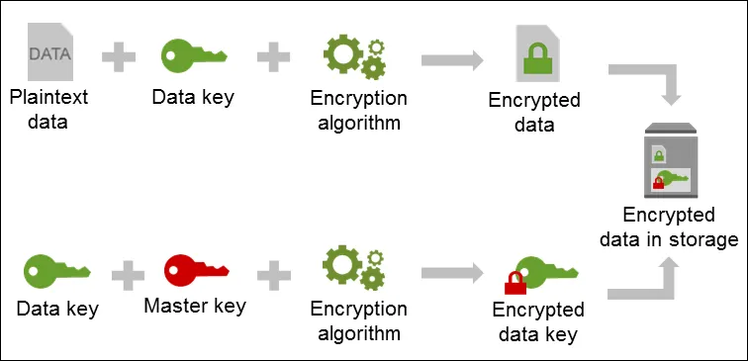

Slide 7
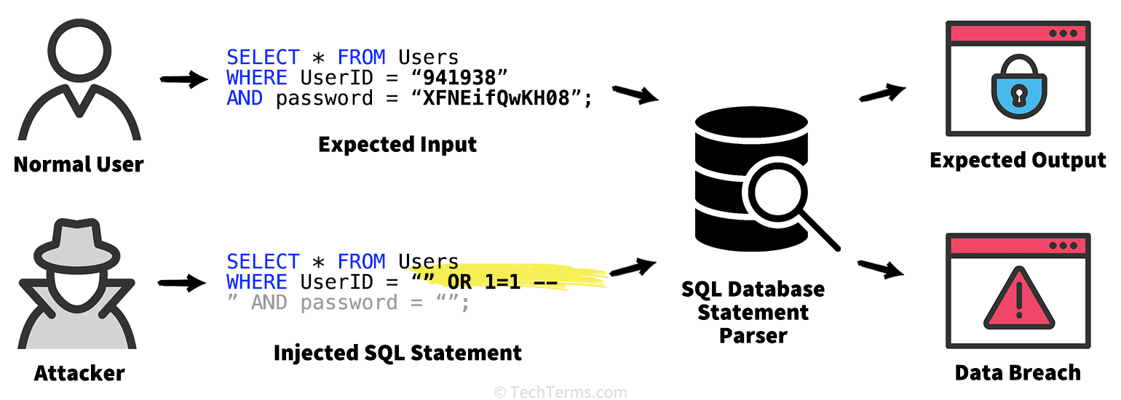
What is SQL Injection?

Slide 8
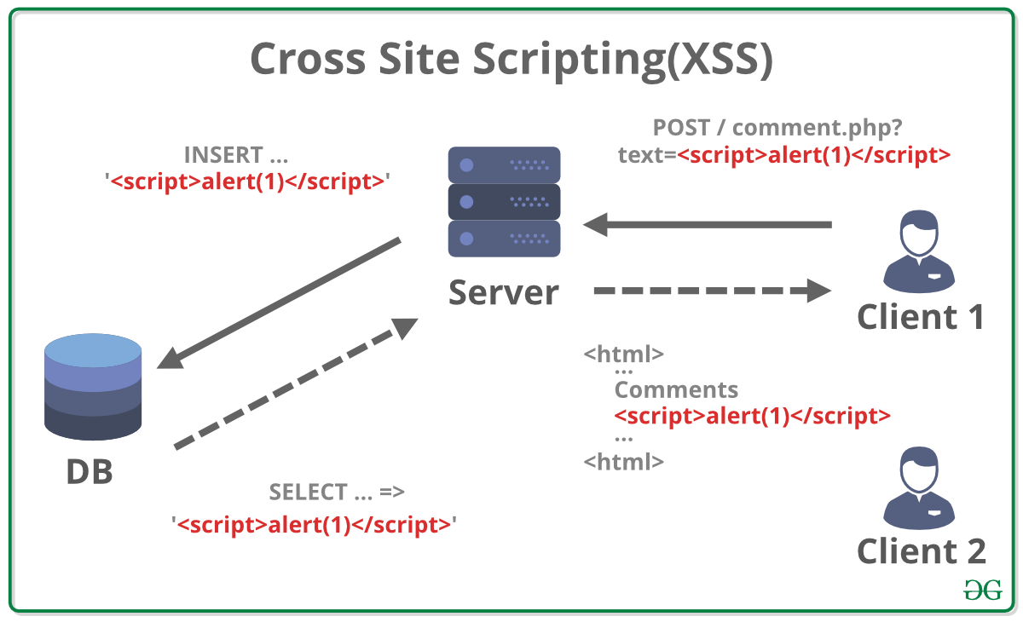

Slide 9
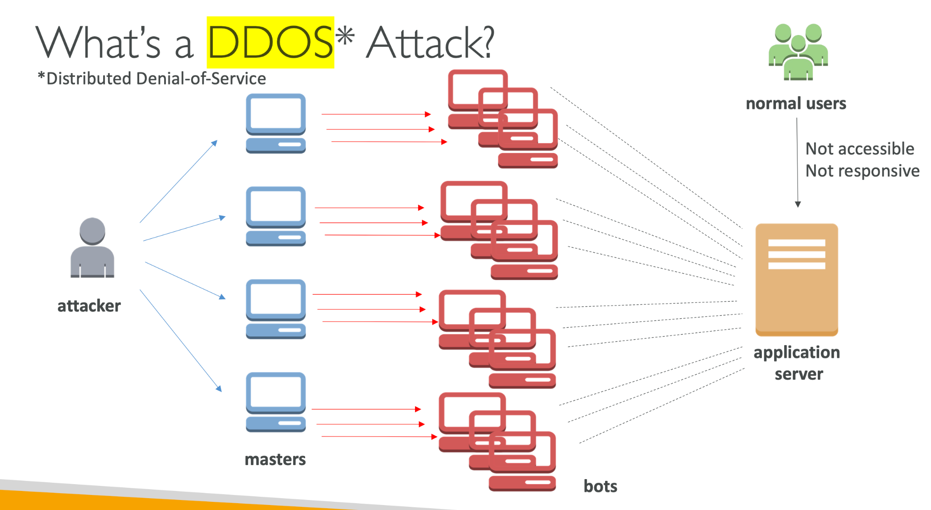

Slide 10
AWS Web Application Firewall (WAF)
AWS WAF protects applications from SQL Injection, XSS, and DDoS attacks.
Works with ALB, API Gateway, and CloudFront.
Uses WebACLs (Web Access Control Lists) for filtering requests.
Can block, allow, or monitor requests based on rules.

Slide 11
How AWS WAF Works
WebACL Rules define what traffic is allowed or blocked.
Managed Rules help block common threats.
Rate-based rules protect against brute force and DDoS attacks.
Works with Shield for enhanced DDoS protection.

Slide 12
AWS Shield for DDoS Protection
AWS Shield provides DDoS protection for applications.
Two types:
  AWS Shield Standard (free, automatic protection)
  AWS Shield Advanced (paid, 24/7 response, insurance)
Integrated with CloudFront, Route 53, and WAF.

Slide 13
AWS Security Best Practices
Enable AWS Shield and WAF for web applications.
Use KMS for encrypting sensitive data.
Implement IAM policies with least privilege access.
Monitor security events using CloudWatch and CloudTrail.
Regularly update WAF rules to prevent new threats.

Slide 14
Summary
AWS KMS encrypts and manages keys securely.
AWS WAF protects applications from common web threats.
AWS Shield provides DDoS mitigation.
Security best practices involve encryption, monitoring, and access control.

Slide 15
THANK YOU
Amel charoline
Amel Online & Irene magdalena
https://github.com/siagianp
https://www.youtube.com/@AmelOline/videos
https://github.com/amelcharolinesgn2/Cloud-Infrastructures
https://github.com/amelcharolinesgn2/ClouD-Infrastructure-SISKA-2025
https://github.com/amelcharolinesgn2/CCNA1
https://github.com/amelcharolinesgn2/CCNA2
https://github.com/amelcharolinesgn2/AWS Certificate

